Slide 1
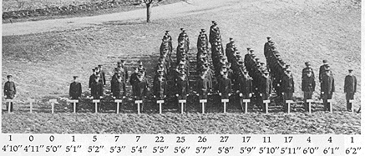
Human height is well described by a normal distribution
Imagine:
True mean ht.: 148
True standard deviation: 12
A sample of 10 humans yielded an average height of 151cm (the true mean equals 148).
Why did the mean of the sample not equal the population’s true mean ?
Unlucky
Sampling error
Standard deviation
Variance
Modified from: Albert Blakeslee, Journal of Heredity, Volume 5, Issue 11, November 1914, Pages 511–518
Notes:
Answer: b

Slide 2
A student measured the heart-rate of 9 humans. The standard deviation of the sample equaled 3 beats per minute (bpm). The mean heart rate equaled 70 beats per minute.
How do we report the mean ± SE heart rate for this sample?
70 ± 1 bpm
9 ± 3 bpm
70 ± 3 bpm
70 ± 9 bpm
Notes:
Answer: a – note that we calculate SE as standard deviation / sqrt(sample size), which equals 3 / sqrt(9) = 1

Slide 3
Imagine that we have obtained a sample of individuals and measured some trait of each individual (e.g., reaction time).
Select the best option from below.
The sample’s standard deviation will be larger than the standard error
The sample’s standard error will be larger than the standard deviation
It is impossible to know whether standard deviation will be larger than the standard error
Notes:
Answer: a (to calculate SE, we divide sd by a number larger than 1 (we need at least a sample size of 2 to calculate sd I the first place), so SE must be smaller than sd).

Slide 4
I am creating a figure that shows average values for a series of groups (e.g., for 1-factor GLM, similar to 1-way ANOVA). I want to include error bars that show the influence of sampling error in my ability to estimate the mean of each group.
My error bars should be:
The standard deviation of my sample.
The variance of my sample.
The standard error of my sample.
Notes:
Answer: c (SE reflects the influence of sampling error on an estimate)

Slide 5
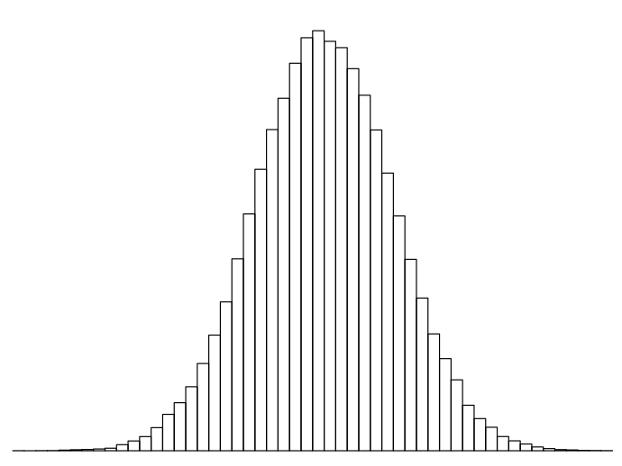
95% of the area under a normal distribution is found between:
The mean ± 1 standard deviation from the mean
The mean ± 1 variance from the mean
The mean ± 2 standard deviations from the mean
The mean ± 1.96 standard deviations from the mean
x s.d.
mean
x s.d.
Notes:
Answer: d

Slide 6
A researcher aims to estimate the true transmission rate of covid-19. The plot, above, indicates the mean and 95% CI’s for the estimated transmission rate.
What is the probability that the true transmission rate falls within the 95% CI’s?
95%
5%
1.95 * SE
Difficult to know
Notes:
Answer: d; for any 95% CI that we calculate, the true value either will or will not fall within the range of 95% CI’s; we just don’t know which. But, speaking more generally, if we performed many experiments like this one and calculated 95% CI’s for each experiment, 95% of tehresults from those experiments will have 95% CI’s that include the true value (assuming our method to estimate transmission rate is unbiased).

Slide 7
If we repeated our experiment many times and calculated a 95% CI each time, the 95% CI’s would include the “true” value (assuming assumptions are met) 95% of the time.
A (much!) more ‘casual’ view of a 95% CI would be:
The probability of making a correct conclusion
A range of ‘plausible’ values for something that we aim to estimate
The range of values for a Type 1 error
A measure of variance
Notes:
Answer: b

Slide 8
Difference between two means
A statistical analysis produces an estimate of the difference between means of two groups, and 95% CI’s for that difference.
The result is plotted, above, and the dotted line indicates a value of zero.
The difference between the means is statistically “non-significant”
The difference between the means is “statistically significant”
It is impossible to know whether the difference differs significantly from zero, given the information above.
Notes:
Answer: a. Think of it this way (very loosely): the dotted line equals zero; since the 95% CI’s for the difference between the two means, we may (casually) say that zero is a ‘plausible’ value for the difference between the two means. i.e., it is plausible that there’s no difference between the means of the two groups. (i.e., we have little evidence to say there is a difference between the means of the two groups.)

