Slide 1
2-sample t-tests
1) What can they do?
2) How do they work?
3) How to perform 2-sample t-test in R?
1

Slide 2
Comparing averages between two groups
i) How big is the difference between these two groups?
(…and how much uncertainty accompanies this estimate?)
ii) Do we have evidence whether the difference differs from zero?
2

Slide 3
2-sample t-test
vs.
“Apple” by idpams CC BY 2.0
“Orange” by wuestenigel CC BY 2.0

Slide 4
2-sample t-test
How does it work?
X₁ – X₂
t =
s_{p}
4

Slide 5
2-sample t-test
How does it work?
X₁ – X₂
t =
s_{p}
Measure of
uncertainty in difference
between means
Difference between
the means
t-value essentially estimates the difference between two means, corrected for uncertainty in this difference
What makes ‘t’ big vs. small? THINK
5

Slide 6
2-sample t-test
How does it work?
X₁ – X₂
t =
s_{p}
Measure of
uncertainty in difference
between means
Difference between
the means
t-value essentially estimates the difference between two means, corrected for uncertainty in this difference
Bigger t: bigger difference in means, or less uncertainty
6

Slide 7
Assumptions of 2-sample t-test
Random sampling
Independence
Homogeneity of variances (no outliers)
Normality within each group (no outliers)
Plot your data!

Slide 8
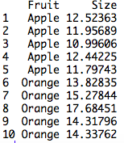
An example in R
Set up data:

Slide 9
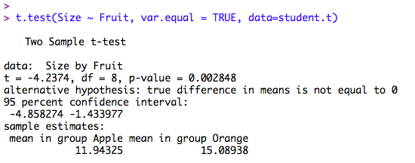
An example in R
Set up data:

Slide 10
An example in R
Set up data:
What was the average size of apples
and oranges?
What is the difference (with uncertainty)
between apples and oranges?

Slide 11
An example in R
Set up data:
Do our data suggest that
apples and oranges differ
in size, on average?

Slide 12
An example in R
Set up data:
“Our samples indicates that, on average, apples (mean mass +/- SE: 11.9g +/- 0.3) and oranges (15.1 +/- 0.7) differ in mass by (95% CI) 1.43 – 4.86 g, which differs significantly from zero (2-sample t-test; t = 4.24, df = 8, p = 0.0028).” Plot data; indicate sample size.

