Slide 1
Welch’s 2-sample t-test
1) What can it do?
2) How does it work?
3) How to perform Welch’s t-test in R?
Note: this video is intended to follow the video regarding
a (standard) 2-sample t-test
1

Slide 2
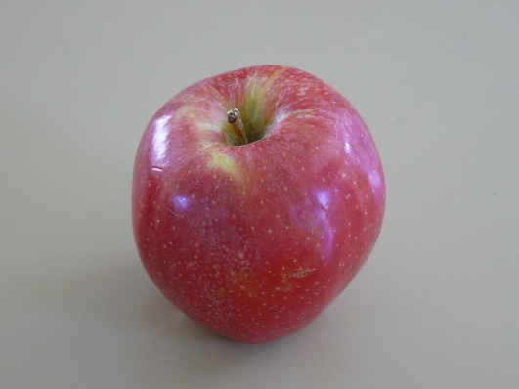
Welch’s 2-sample t-test
Does the average mass of an apple differ significantly from
the average mass of an orange?
vs.
Allows unequal variance
“Apple” by idpams CC BY 2.0
“Orange” by wuestenigel CC BY 2.0

Slide 3
Welch’s 2-sample t-test
How does it work?
X₁ – X₂
t =
s_{p}
Difference between
the means
Measure of uncertainty
Adjusts degrees of freedom (d.f.); d.f., may be a fraction
3
Notes:
Yes, calculates s_p differently and uses different df.

Slide 4
Assumptions of Welch’s 2-sample t-test
Random sampling
Independence
Homogeneity of variances (no outliers)
Normality within each group (no outliers)
Plot your data!

Slide 5
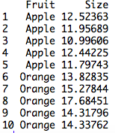
An example in R
Set up data:

Slide 6
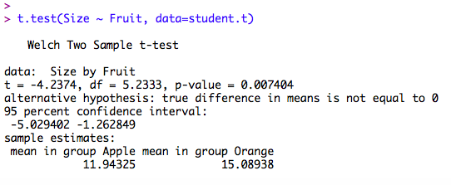
An example in R
Set up data:

Slide 7
An example in R
Set up data:
What is the average size of apples?
Oranges?
What is the estimated difference in mass
between apples and oranges?

Slide 8
An example in R
Set up data:
Do our data suggest that
apples and oranges differ
in size, on average?

Slide 9
An example in R
Set up data:
“Our samples indicates that apples (mean
mass +/- SE: 11.9g +/- 0.3) and oranges
(15.1 +/- 0.7) differ in mass by (95% CI)
1.26 – 5.02 g, which differs significantly
from zero (Welch’s t-test; t = 4.24, df = 5.23,
p = 0.0074).” Plot data, too; state sample sizes

