Slide 1
Paired t-test
1) What can it do?
2) How does it work?
3) How to perform 1-sample t-test in R?
Note: this video is intended to follow the videos regarding
the (standard) 2-sample t-test and 1-sample t-test
1

Slide 2
Paired t-test
Compares difference between two groups when data are paired
2

Slide 3
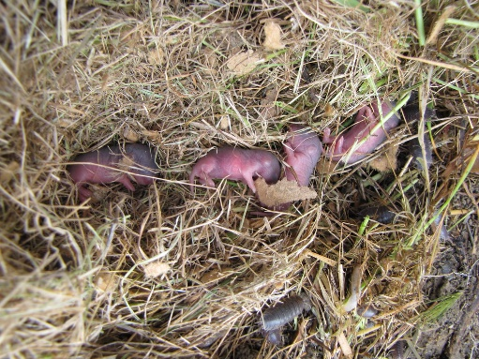
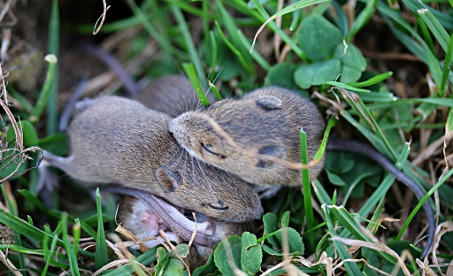
Paired t-test
Compares difference between two groups when data are paired
Drug
Placebo
Family 1
“baby mice under a board” by Derell Licht CC BY-ND 2.0
Family 2
“baby mice” by Nick Goodrum Photography CC BY 2.0
…
Family n
3

Slide 4
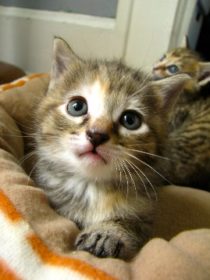
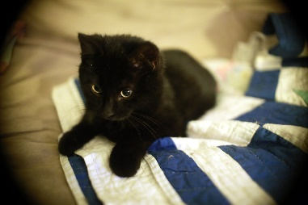
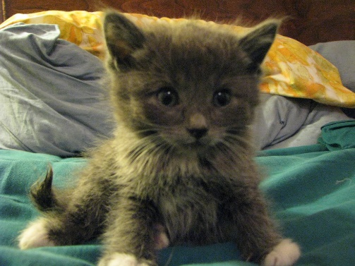
Paired t-test
Compares difference between two groups when data are paired
Before
After
“Kittens!” by London looks CC BY 2.0
“Kitten!” by Martin Cathrae CC BY_SA 2.0
“Kitten!” by mtrichardson CC BY 2.0
4

Slide 5
Paired t-test
Compares difference between two groups when data are paired
Treatment 1
Treatment 2
Day 1
Day 2
…
…
Day n
5
“Mad scientist at the DEN virtual conference-1” by krossbow CC BY 2.0 “Sylvia @ Mad Evil Scientist 6” by oskay CC BY 2.0

Slide 6
Paired t-test
Compares difference between two groups when data are paired
Treatment 1
Treatment 2
Day 1
Day 2
Pairing helps control for random variation in your data
…
…
Day n
6
“Mad scientist at the DEN virtual conference-1” by krossbow CC BY 2.0 “Sylvia @ Mad Evil Scientist 6” by oskay CC BY 2.0

Slide 7
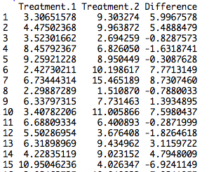
Paired t-test
How does it work?
Paired t-test analyzes the difference between the pairs
Does the difference differ significantly from zero?
7

Slide 8
Paired t-test
How does it work?
X_{diff} – 0
t =
s_{p}
“Kitten!” by Martin Cathrae CC BY_SA 2.0
Difference between
mean difference and 0
Estimate of
uncertainty (SE) of
difference (X_{diff})
8

Slide 9
Assumptions of paired t-test
Pairs randomly sampled
Independence of pairs
Differences are normality distributed (no
outliers)
Plot the differences!

Slide 10
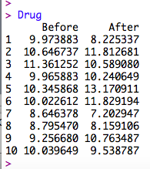
An example in R
Set up data:
Does hair density change after
being given a drug?

Slide 11
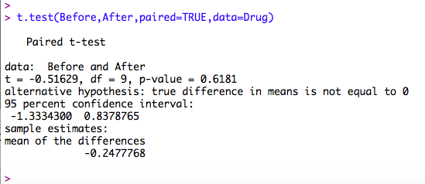
An example in R
Set up data:
Does hair density change after
being given a drug?

Slide 12
An example in R
Set up data:
Does hair density change after
being given a drug?

Slide 13
An example in R
Set up data:
What mean is reported?
What does the 95% CI refer to?
Notes:
95% CI refers to estimate of the average **difference**

Slide 14
An example in R
Set up data:
Do we have any evidence that the
drug changed hair density?
Notes:
95% CI refers to estimate of the average **difference**

Slide 15
An example in R
Set up data:
The average difference in hair density
pre- vs. post- drug application (95%
CI: -1.33 to 0.83 follicles per
cm²) did not differ significantly from
zero (paired t-test, t=0.51, df = 9,
p = 0.61). Plot raw data, too

