Slide 1
1-sample t-test
1) What can it do?
2) How does it work?
3) How to perform 1-sample t-test in R?
Note: this video is intended to follow the video regarding
a (standard) 2-sample t-test
1

Slide 2
1-sample t-test
Does the average mass of an apple differ significantly from μ?
μ
2

Slide 3
1-sample t-test
How does it work?
μ
X₁ – μ
t =
s_{p}
Estimate of
uncertainty (SE) in X₁
Difference between
the mean and value
of interest
3

Slide 4
Assumptions of 1-sample t-test
Random sampling
Independence
Normality within the group (no outliers)
Plot your data!

Slide 5
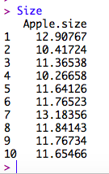
An example in R
Set up data:

Slide 6
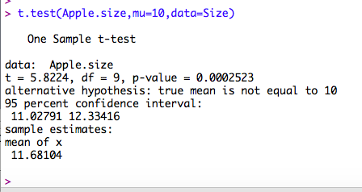
An example in R
Set up data:
Does average apple size differ
significantly from 10g?

Slide 7
An example in R
Set up data:
“The average size of apples (mean +/- SE:
11.68 g +/- 0.29 g) differs significantly from
10 g (1-sample t-test; t=5.8, df = 9,
p = 0.00025).” Plot data, too.
Notes:
Can explain why it is sufficient to report the SE for the mean → easily calculate 95% CI

