Slide 1
Questionable Research Practices
A general introduction

Slide 2
How do we judge whether a scientist is ‘successful’?
Number of publications
The journals in which publications occur
Evidence of acquiring grants
Reputation (good thinker, good mentor)

Slide 3
How do we judge whether a scientist is ‘successful’?
Number of publications
The journals in which publications occur
Evidence of acquiring grants
Reputation (good thinker, good mentor)
How robust is a scientist’s research?

Slide 4
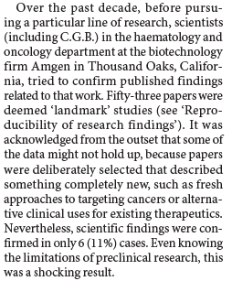
Many studies are not reproducible

Slide 5
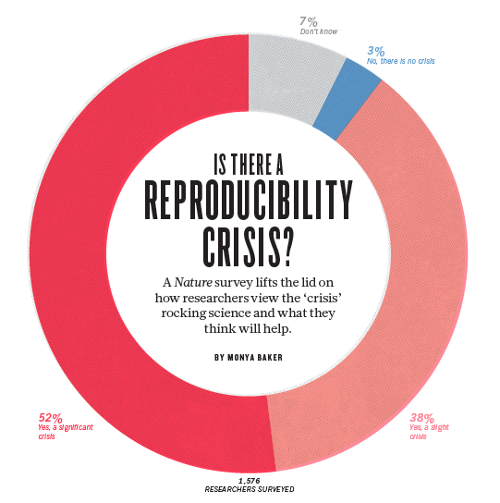

Slide 6
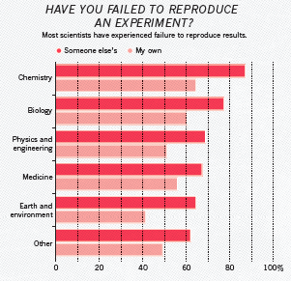

Slide 7
Many studies are not reproducible
Replicated 39% of results
(a subjective measure)

Slide 8
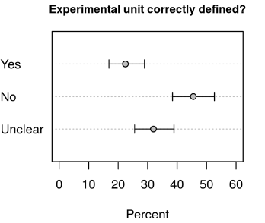
Problems with experimental design
“Experimental interventions were applied
at one level (the parents) but effects were
examined at another level (in the offspring)”

Slide 9
Problems with experimental design

Slide 10
Problems with experimental design

Slide 11
Questionable research practices
Cherry-picking
P-hacking
HARKing

Slide 12
Science works
Vaccines & medicine
Efficient breeding (e.g., crops)
Genetic engineering
Put people on the moon
But, we can do better:
Wasted animal lives
Wasted resources
Wasted time

