Slide 1
Plotting data effectively
What’s possible?

Slide 2
The possibilities for plotting data are as varied as biological studies

Slide 3
Whitlock & Schluter (“The analysis of biological data”, Ch. 2) establish 4 principles for effective graphs:
Show the data
Make patterns in the data easy to see
Represent magnitudes honestly
Draw graphical elements clearly

Slide 4
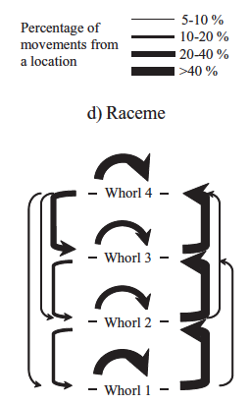
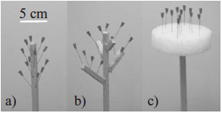

Slide 5
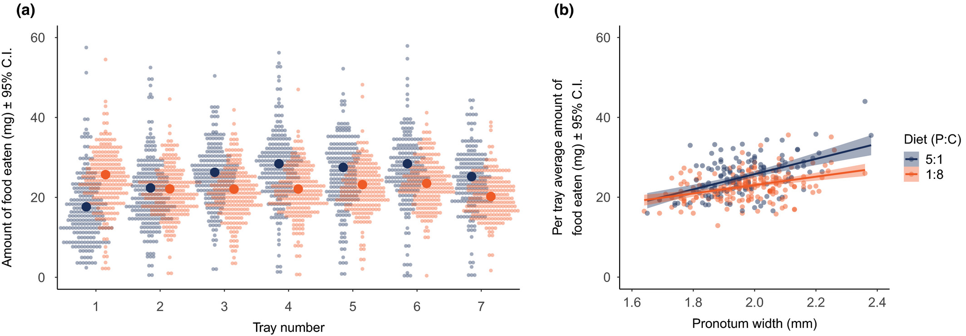

Slide 6
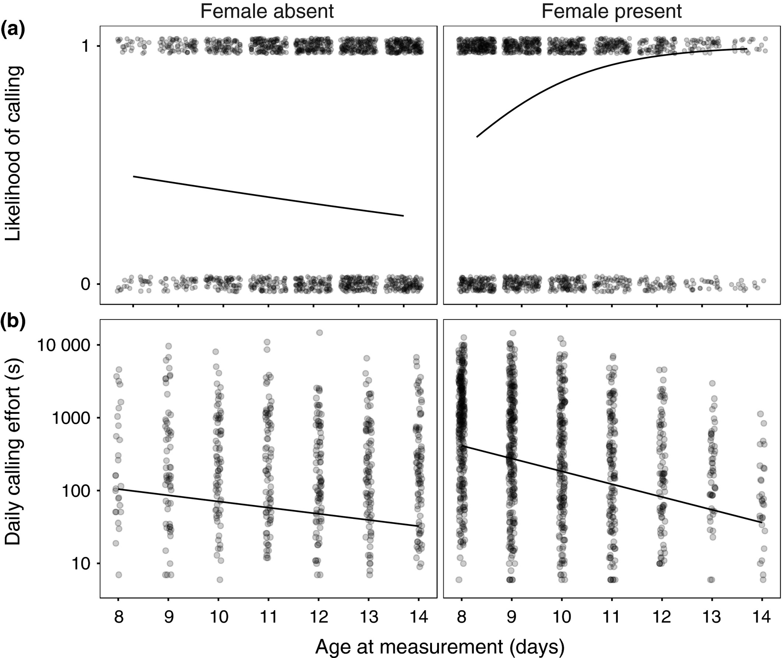

Slide 7
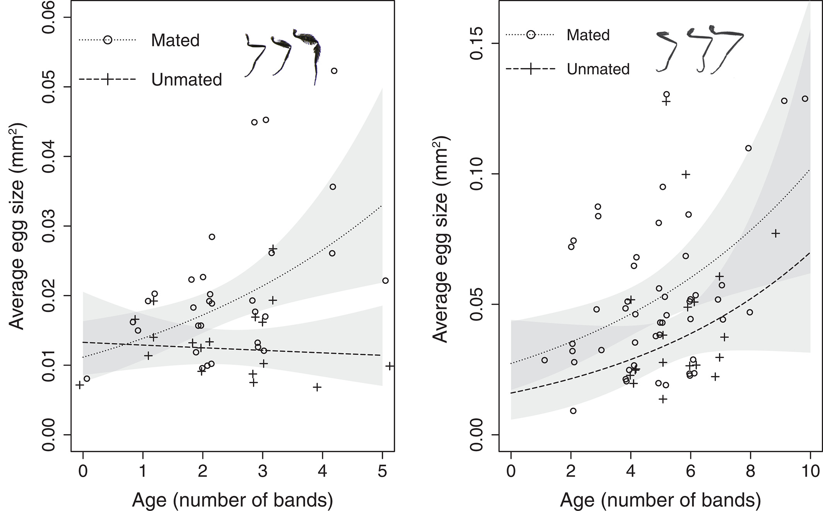

Slide 8
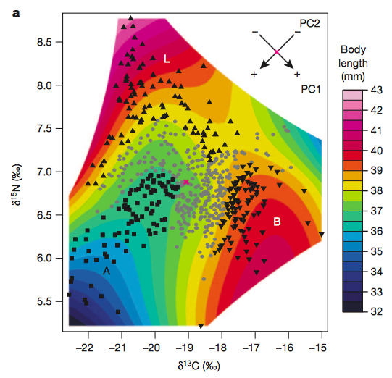

Slide 9
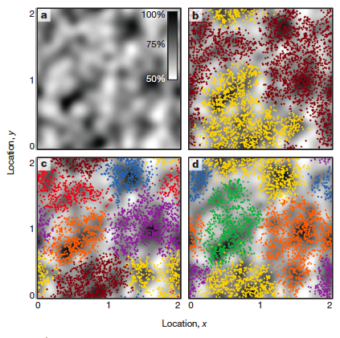

Slide 10
The possibilities for plotting data are as varied as biological studies A plot should communicate the biology that we aim to understand

