Slide 1
‘Statistical significance’ vs. ‘Effect size’
Proposal to abandon the notion of ‘statistical significance’

Slide 2
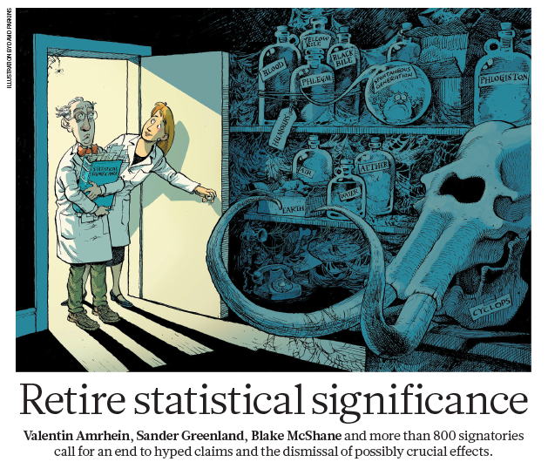

Slide 4
Lead authors on both papers are biologists.
The arguments in these papers are not new.

Slide 5
Basics: what is “effect size”
“Effect size” = estimated size of an effect
e.g., size of difference between treatments
e.g., slope of relationship between variables
e.g., probability of recovery after receiving drug

Slide 6
Reminder: what is “statistical significance”
p < 0.05 “Statistically significant”
p > 0.05 “Statistically non-significant”
Upcoming arguments do not criticize use of p-values, but the use of threshold (critical) values to reach conclusions.

Slide 7
What is wrong with the notion of “statistical significance”? Explore by example…
Two studies examine evidence whether a drug has a side-effect of new-onset atrial fibrillation.
Study 1: “Statistically significant” association between the drug and onset of atrial fibrillation.
Study 2: “Statistically non-significant” association between the drug and onset of atrial fibrillation.
…Researchers claims contradictory results

Slide 8
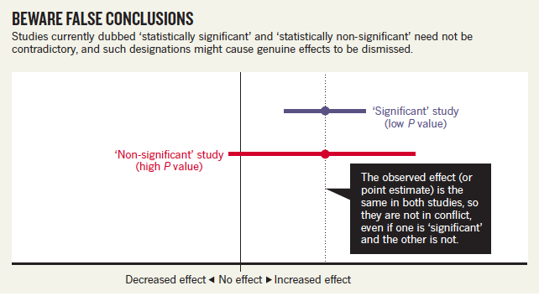
Were the results contradictory?
Point estimates are the same: risk ratio = 1.2
Latter study: 95% CI: -3% to + 48%

Slide 9
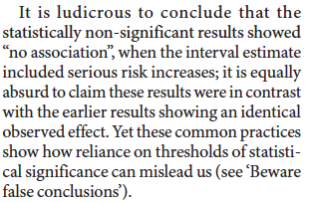
Were the results contradictory?
Point estimates are the same: risk ratio = 1.2
Latter study: 95% CI: -3% to + 48%

Slide 10
Why do such incorrect conclusions arise?
Misunderstanding that p > 0.05 means “no effect”.
Tendency to dichotomize conclusions (effect vs. no effect).

Slide 11
p > 0.05 does not mean “no effect”
Simple logic: An effect might be real but very small, making
it difficult to detect.
Imagine if p > 0.05 did mean “no effect”:
Small experiments with little power would be excellent at
“showing no effect”.
(Clearly not true.)
“absence of evidence is not evidence of absence”

Slide 12
If p > 0.05 does not mean “no effect”, what purpose does having a ‘critical p-value = 0.05’ serve?
None.

Slide 13
If p > 0.05 does not mean “no effect”, what purpose does having a ‘critical p-value = 0.05’ serve?
None.

Slide 14
Tendency to dichotomize conclusions (effect vs. no effect)
Effect vs. no effect: attractive because it is simple.
But simple does not mean ‘true’, nor does it mean ‘good’.
Dichotomy:
Greatly over-simplifies interpretation (but correct interpretation need not be complicated);
Leads to bias in reported results in the literature;
Promotes questionable research habits in search of ‘statistical significance’.

Slide 15
Proposed solutions
i) Abandon the concept of “statistical significance”; never say “statistically (non-)significant” again.
ii) Keep using p-values but interpret as a sliding scale of evidence, and consider addition sources of evidence to make conclusions.
iii) Use additional sources of evidence, e.g., effect size.
Notes:
i) The notion of statistical significance provides no benefit but does create confusion.

Slide 16
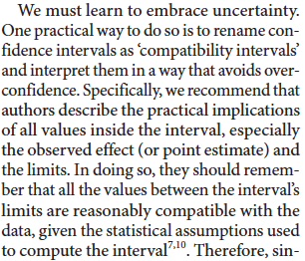
Proposed solutions
Notes:
i) The notion of statistical significance provides no benefit but does create confusion.

Slide 17
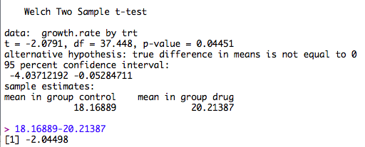
Proposed solutions
Notes:
i) The notion of statistical significance provides no benefit but does create confusion.

Slide 18
Proposed solutions
Note: The choice of 95% CI instead of, say, 99% CI’s is arbitrary.
Therefore, we should think similarly about values that lie just outside the 95% CI’s as values that lie just within.
Notes:
i) The notion of statistical significance provides no benefit but does create confusion.

Slide 19
Proposed solutions
What if we don’t know the “practical importance” of an effect size?
Think.
Acknowledge lack of understanding.
And maybe perform additional research to understand it.
Notes:
i) The notion of statistical significance provides no benefit but does create confusion.

Slide 20
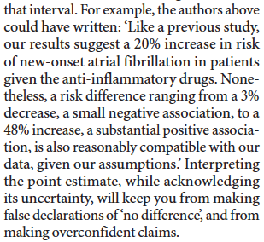
What does the proposed approach look like?
Notes:
i) The notion of statistical significance provides no benefit but does create confusion.

Slide 21
What does the proposed approach look like?
Notes:
i) The notion of statistical significance provides no benefit but does create confusion.

Slide 22
p-value as a sliding scale:
p ~ 0.05 … moderate evidence
p ~ 0.005… ‘substantial’ to ‘strong’ evidence
Notes:
i) The notion of statistical significance provides no benefit but does create confusion.

Slide 23
Summary
The notion of “statistical significance” is addictive, but not helpful and can be harmful. Abandon it.
Report p-values, but interpret as a sliding scale (not dichotomous outcomes).
Use additional sources of evidence to reach conclusions, effect size in particular.
Read Amrhein et al. and Hurlbert et al. for further thoughts.

Slide 24
“CAT” by Bahman Farzad, CC BY 2.0

