Slide 1
P-values do not tell us how important a result is. “Statistical significance” vs. “Biological significance”

Slide 2
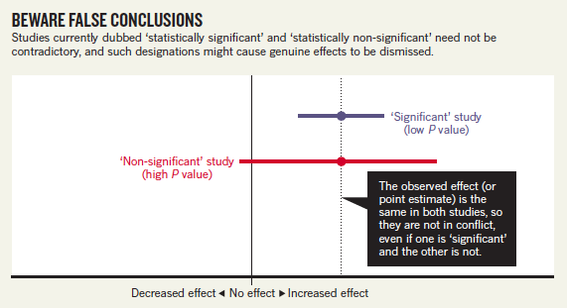
Large p, big importance

Slide 3
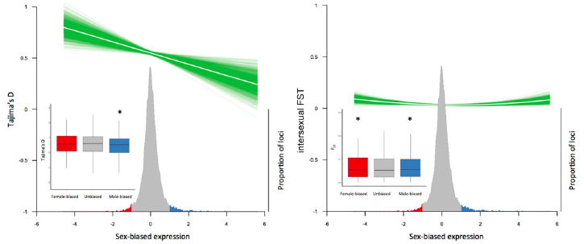
Small p, small importance?

Slide 4
Summary
Size of a p-value: degree of evidence for an effect
Effect size: informs biological importance for an effect

