Slide 1
95% Confidence Intervals
Understanding origin of 95% CI’s: why 1.96?
Note: This video follows the video addressing Standard Error and calculating 95% CIs

Slide 2
95% CI = 1.96 * SE
95% CI = t_{0.05(2),df} * SE

Slide 4
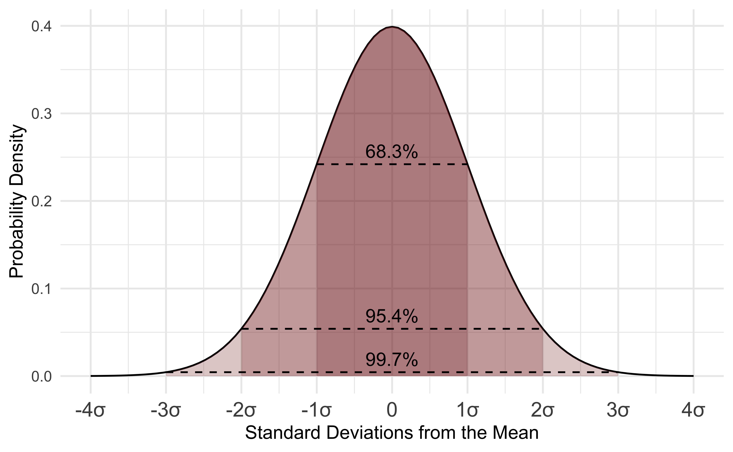
95% CI = 1.96 * S.E. … Why 1.96?
"File:Standard Normal Distribution.png" by D Wells is licensed under CC BY-SA 4.0

